Slide 1

NAILUXE Website Presentation

Slide 2
Software Use in Website
HTML 5/CSS
JAVASCRIPT
BOOTSTRAP
JQUERY

Slide 3
PLUGINS USE IN WEBSITE
Scroll Up Plugins (JQUERY)
Swiper JS Plugins (JQUERY)

Slide 4
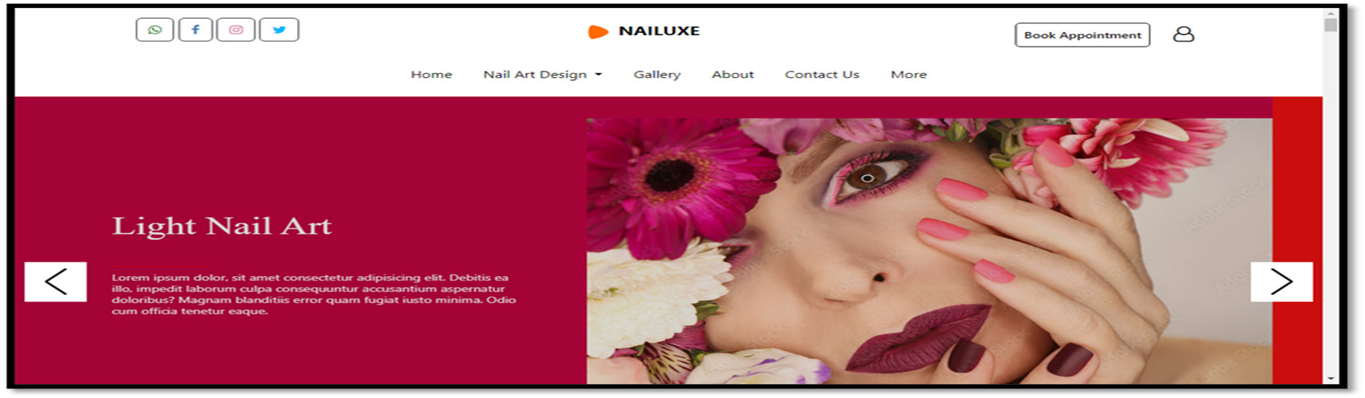
(NAIL ART ) NAVIGATION BAR & CAROUSEL SLIDER
Navigation bar (Bootstrap).
Create navigation links that allow users to navigate through different categories or pages of your website.
Carousel Slider (jQuery).

Slide 5
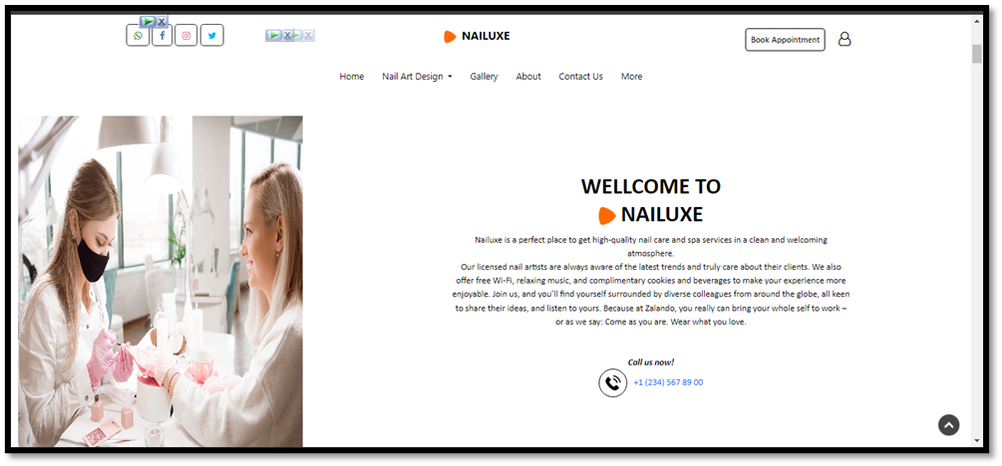
(NAILUXE) ABOUT US
The about us page provides insights into the Nail Art background, including its founding date, location, and the story behind its establishment. Customers can gain a better understanding of the company's vision, mission, and goals.

Slide 6
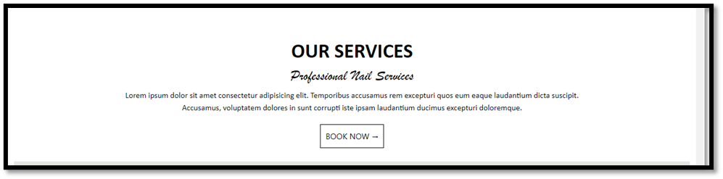
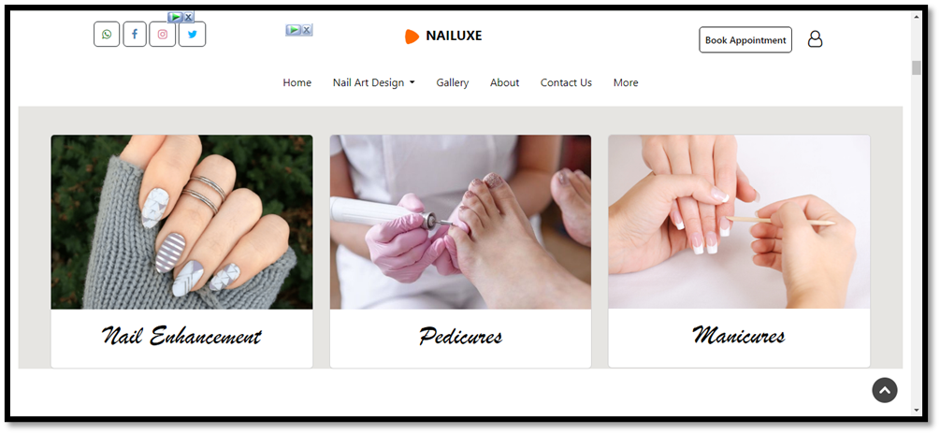
OUR SERVICE
MANICURES
PEDICURES
NAIL ENHANCEMENT

Slide 7
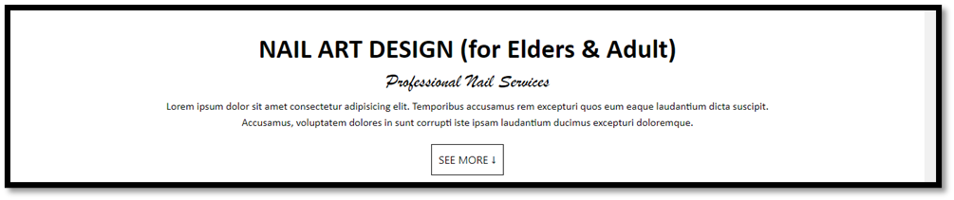
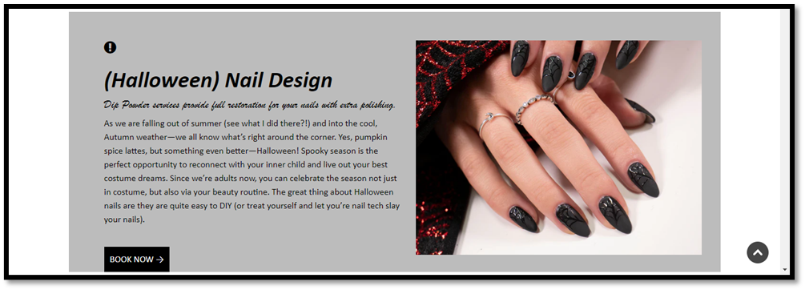
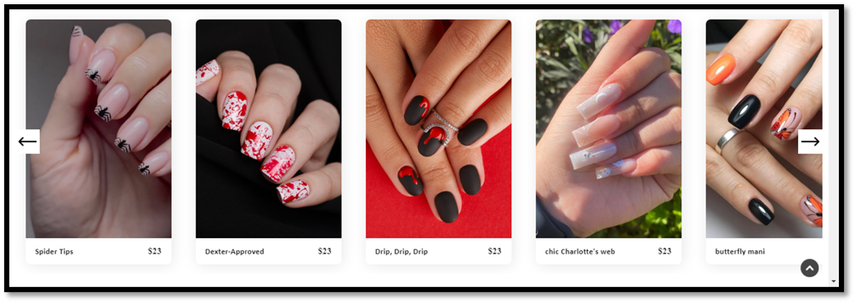
NAIL ENHANCEMENT CATEGORIES
Categories of Nail art design:
Halloween
Geometrical
Floral
Ombre’s
Color-Tip
Categories of Nail art for Kids:
Halloween
String Floral
Cartoon
Disney Princess
Gold Glitter
More

Slide 8
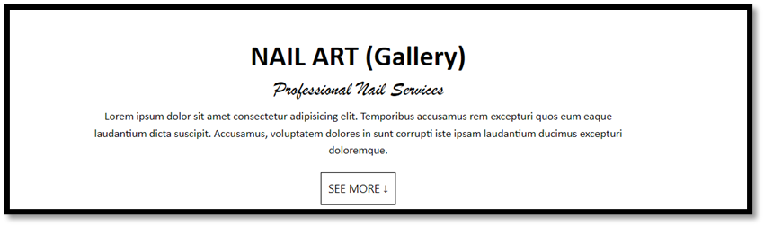
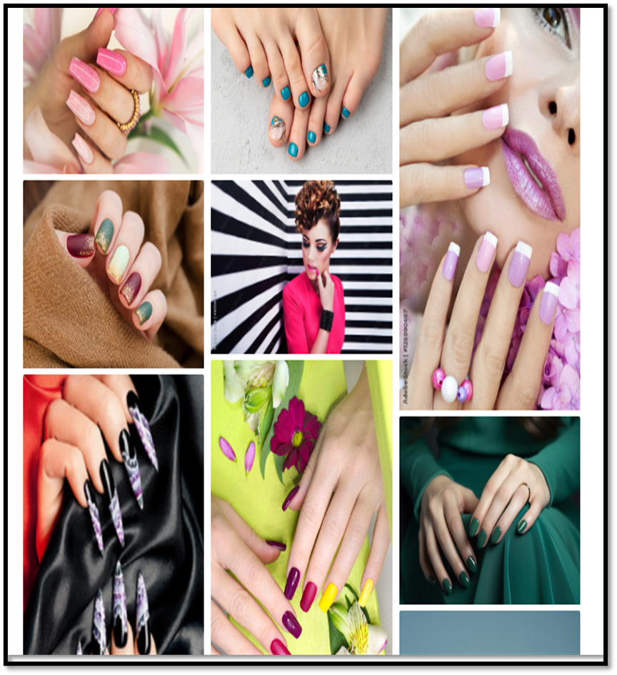
Gallery
On the Gallery page, you can see the different types of Nail Art Design in Gallery Page.

Slide 9
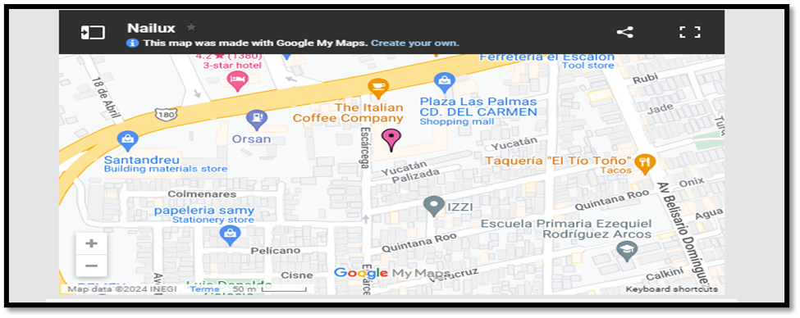
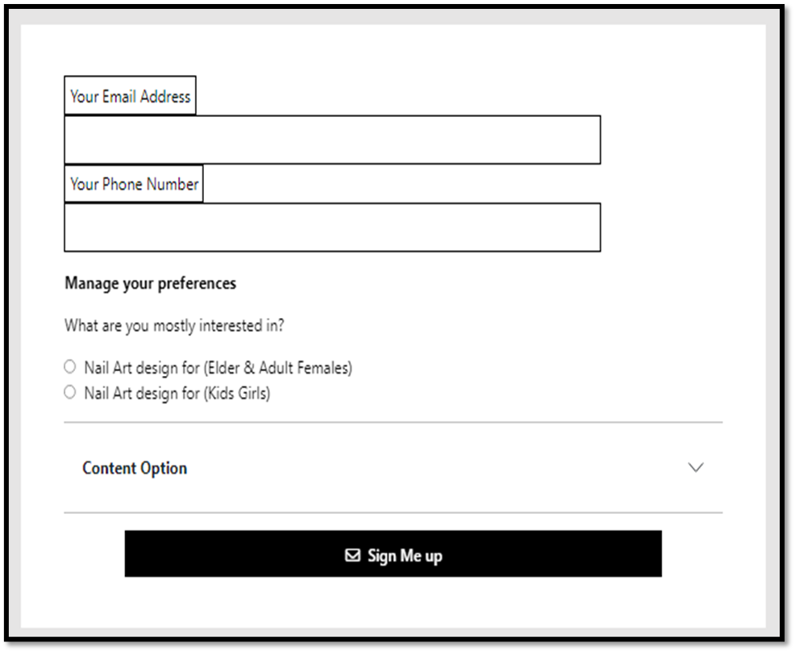
Map Location Contact Us & Feedback Form
On the map location page, you can see the site map location where our (Nailuxe) Salon is located.
On the contact us page, you can Contact Us in Contact Form.

Slide 10
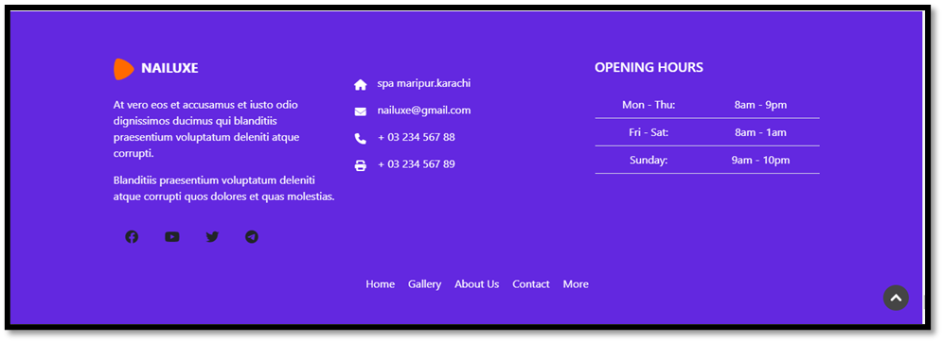

Footer Website INFO
On the Footer page, you can see our Nailuxe Salon address, our email address, our contact number, our website info.

